Slide 1


Phishing Website Detection
Group Assignment 3 – Progressive Demo & Retrospective 1 (15%)
Submitted By: Muhammed Murtuza
Github: github.com/Murtuzamohammed78692/Phishing_Website

Slide 2

Project Status: Background
The structural foundation of the Phishing Website Detection system has transitioned successfully from an abstract concept into a functional data collection, parsing, and cleaning infrastructure.
Operating completely as a solo developer, my technical focus during this initial sprint was to build a data engineering pipeline capable of consolidating web records from multiple sources and preparing them for future model benchmarking.

Slide 3
User Stories Overview
The following user stories from Kanban 1 (Load and Explore Databases) were demonstrated live, showing a status of "Done" in my personal Jira backlog:
User Story K1-1 (Database Ingestion): As a solo developer, I need to programmatically query and load raw datasets from PhishTank, the UCI Machine Learning Repository, and Alexa Top 1 Million logs so that the project contains a comprehensive repository of both phishing and authentic baseline websites.
User Story K1-2 (Exploratory Data Analysis & Cleaning): As a data engineer, I need to use Pandas and NumPy to identify missing structural values, drop duplicate URL streams, and fix data inconsistencies across raw sources.
User Story K1-3 (Feature Engineering Layout): As an ML engineer, I need to write custom Python functions to extract text properties from URLs (lengths, subdomains, special character counts) alongside early HTML script indicators.

Slide 4
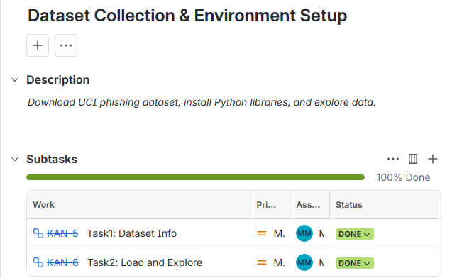
Core Functionality Validated
The progressive demonstration validated the following functional code components:
• Multi-Source Dataset Consolidation: Programmatic merging of crowdsourced malicious links with legitimate corporate domains into a standardized dataset workspace.
• Live Feature Matrix Mapping: Demonstration of the feature engineering scripts dynamically processing raw text input URLs into organized numerical vectors (URL lengths, subdomain counts, and special symbol counts like @, -, and _).
• Reproducible Ingestion Pipelines: A clean script layout utilizing static random seeds to split data into an 80% training matrix and a 20% testing matrix automatically.

Slide 5
Sprint 1 Concluded

